Slide 1
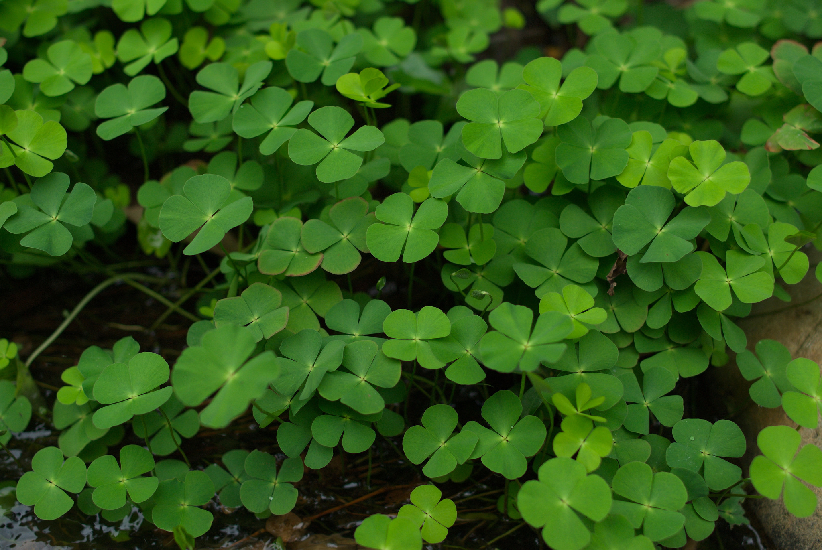
Georgia’s Beneficial and Harmful Plants
This Photo by Unknown Author is licensed under CC BY-SA-NC

Slide 2
Safety First!
As teachers, we want you to be safe even when we are not with you! Here is a little bit of information about Georgia’s plant life! Always remember, you should never eat anything from nature unless your parents tell you it’s safe, DO NOT EAT any unknown plants!

Slide 3
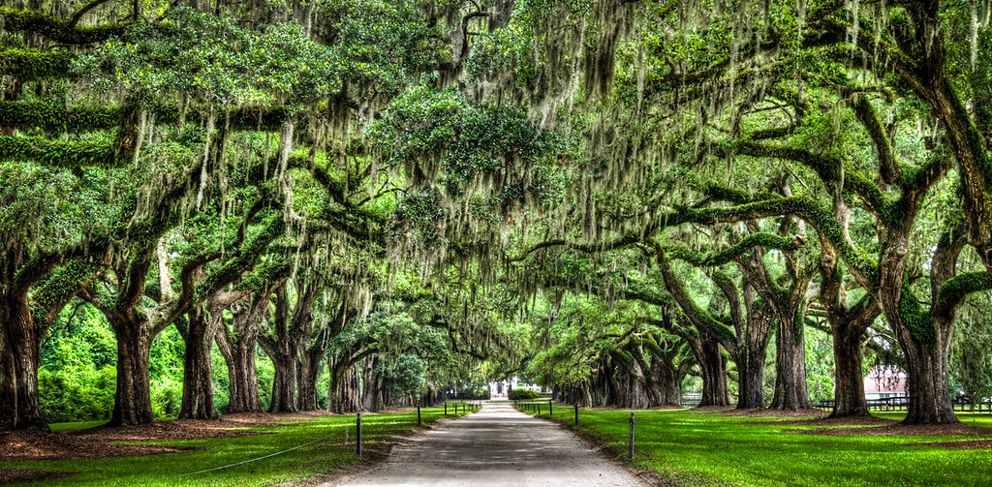
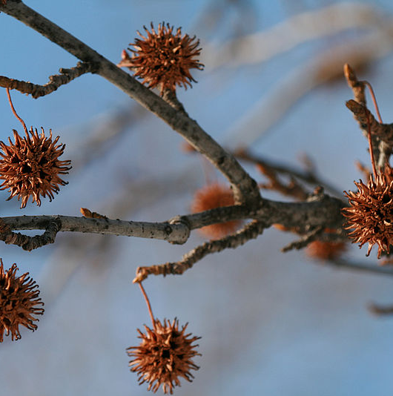
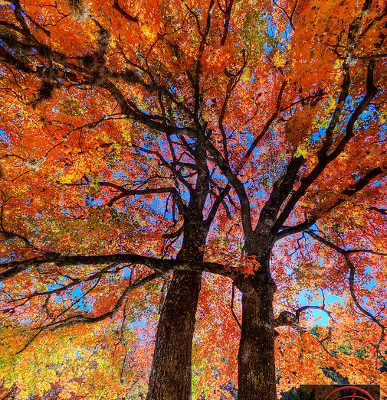
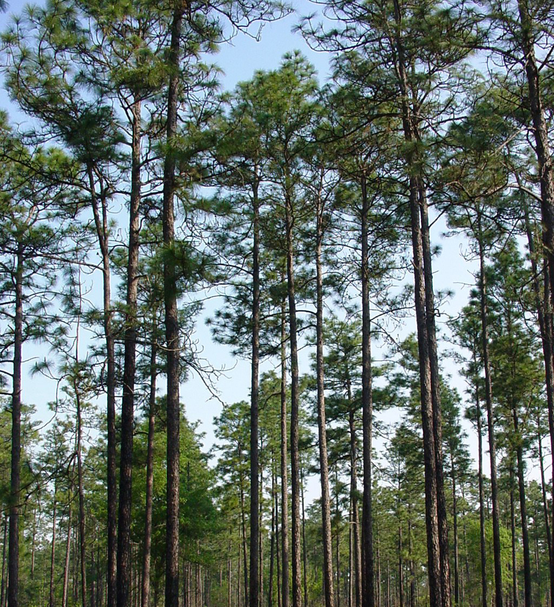
Georgia’s Native Trees
Red cedar
Pines
Oaks
Maples
Sweetgum

Slide 4
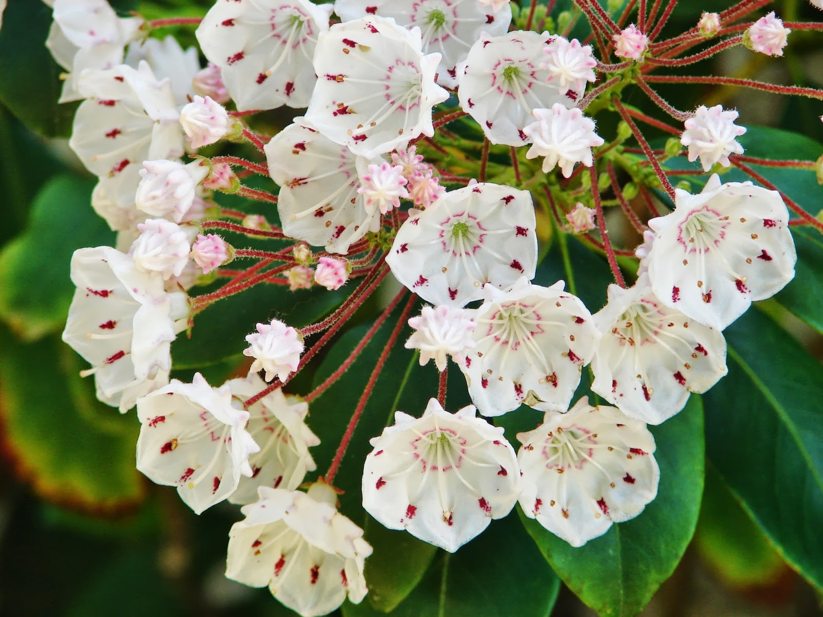
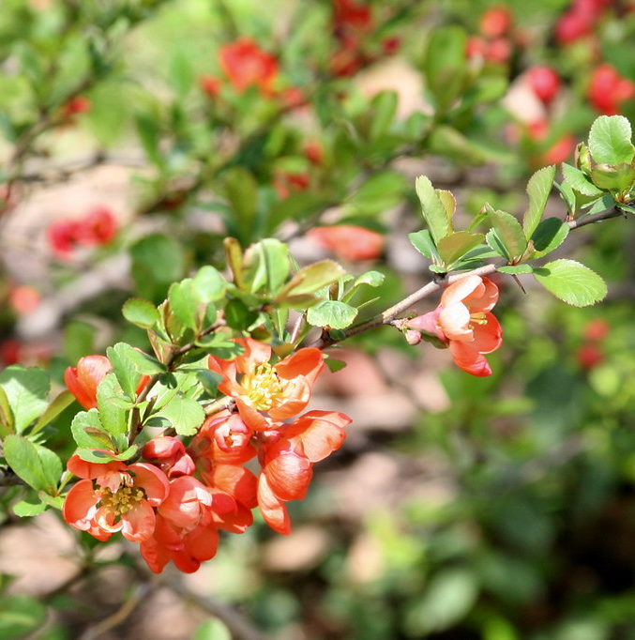
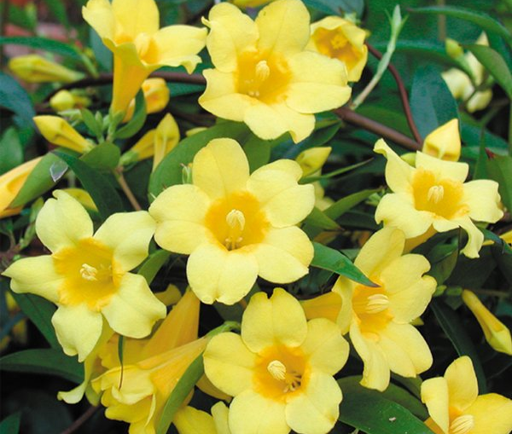
Georgia Plants
Yellow jasmine
Flowering quince
Mountain laurel

Slide 5
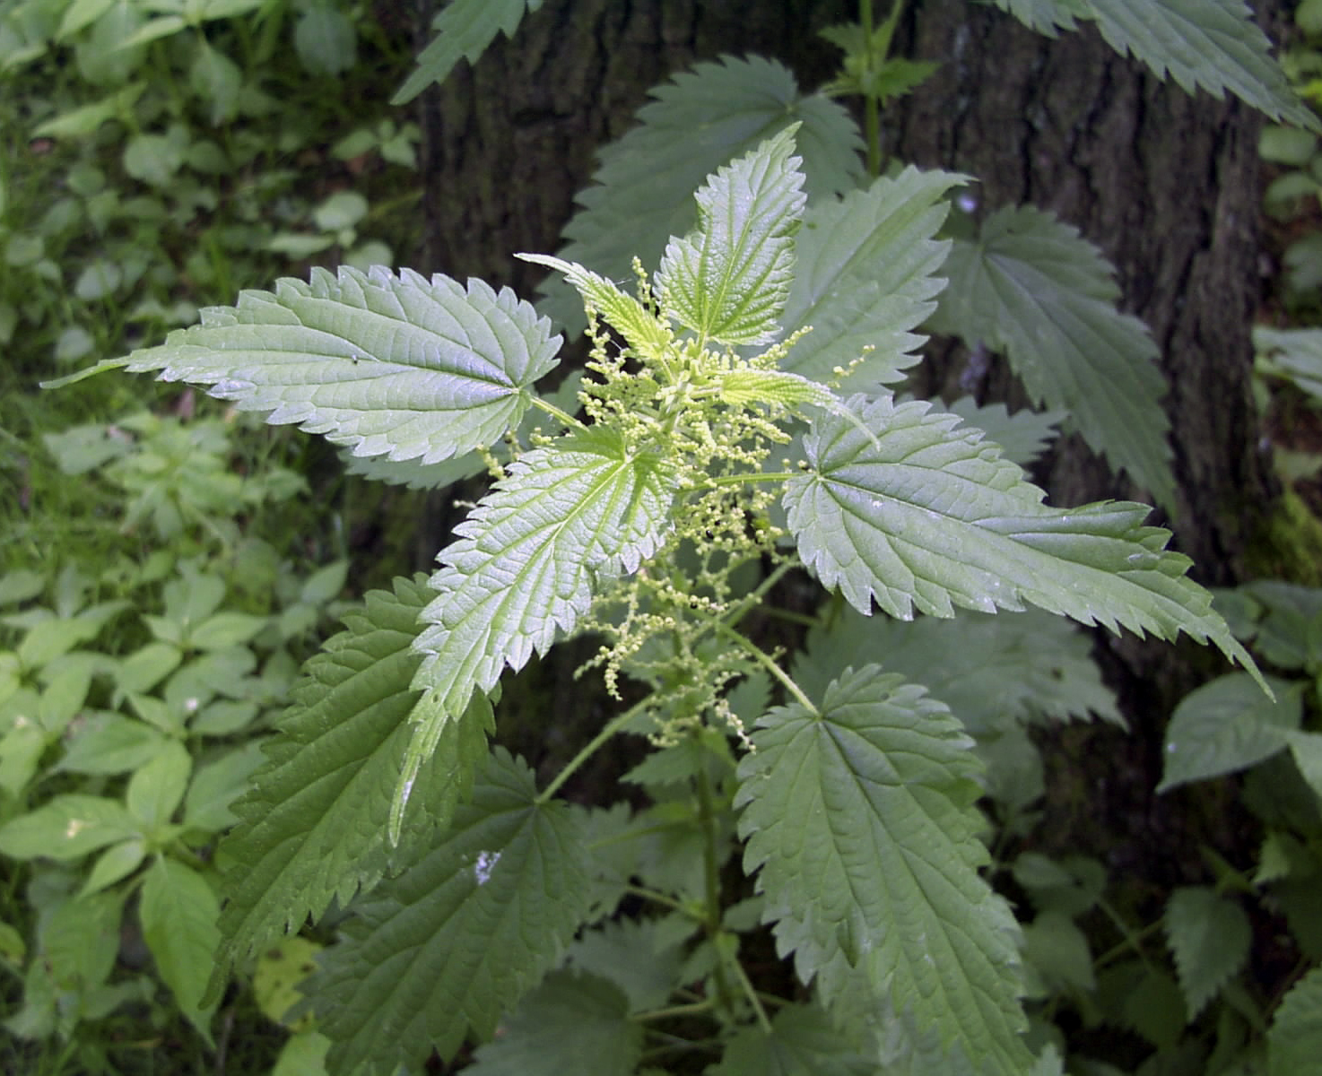
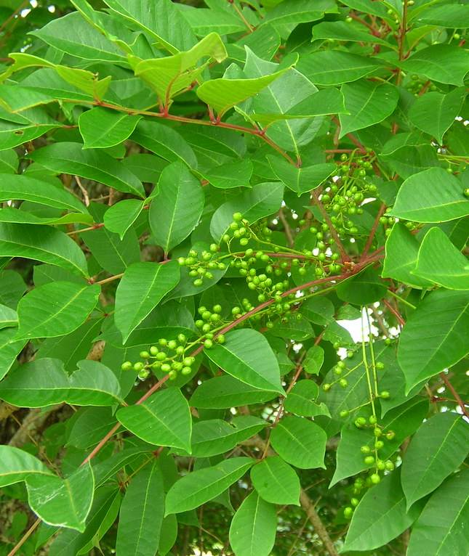
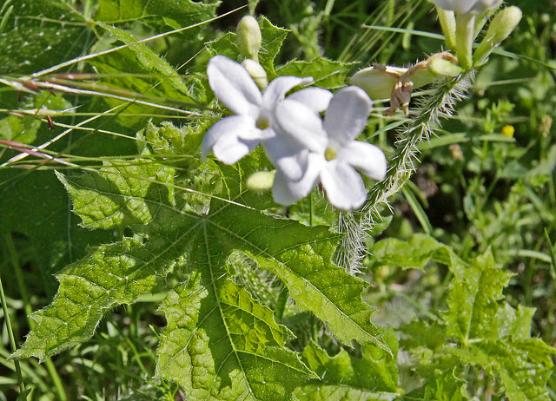
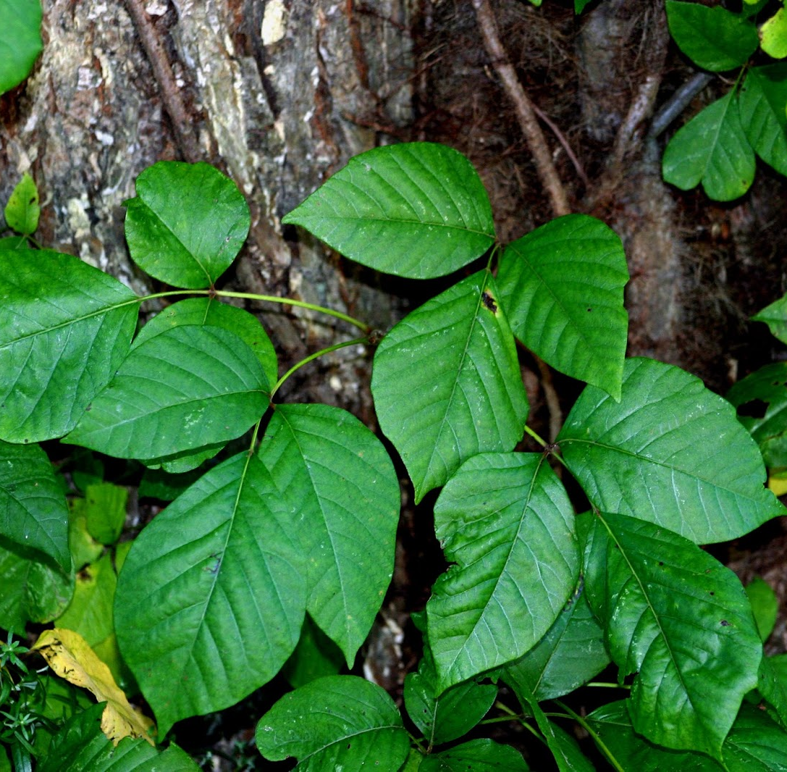
Georgia’s Poisonous Plants
Poison Oak
Poison Sumac
Bull Nettle
Stinging Nettle

Slide 6
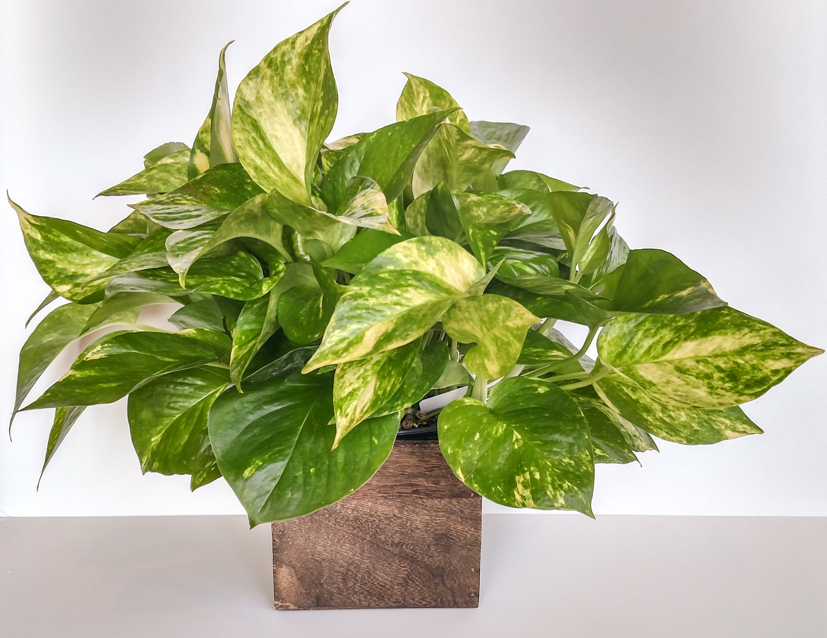
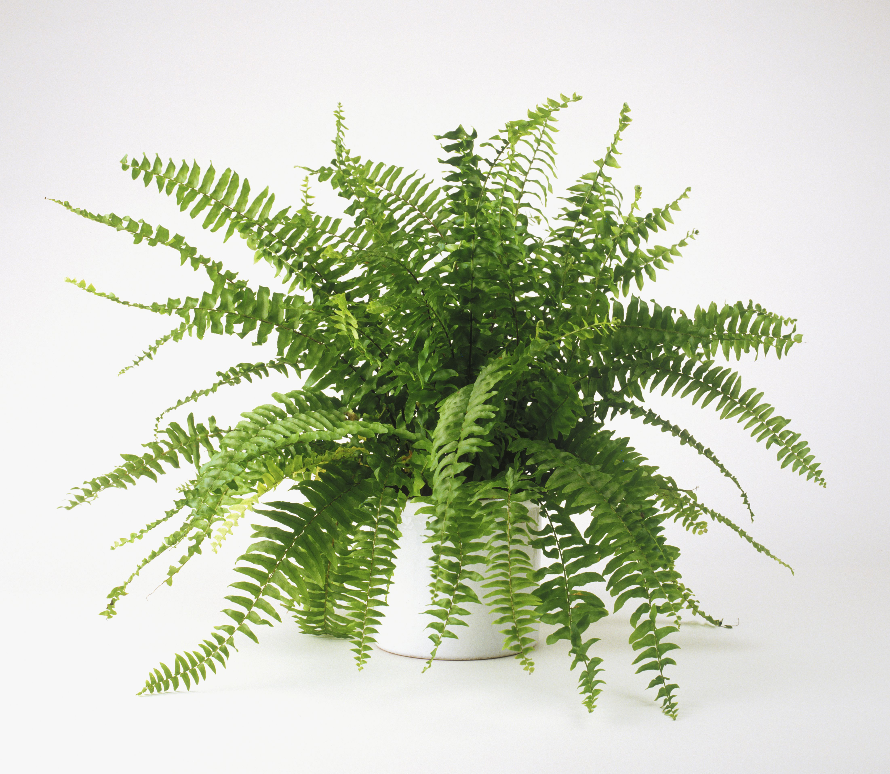
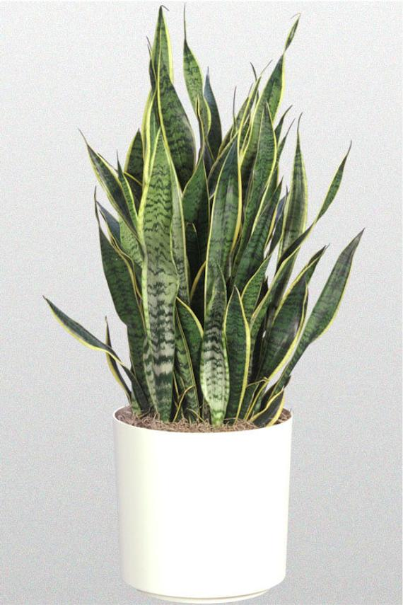
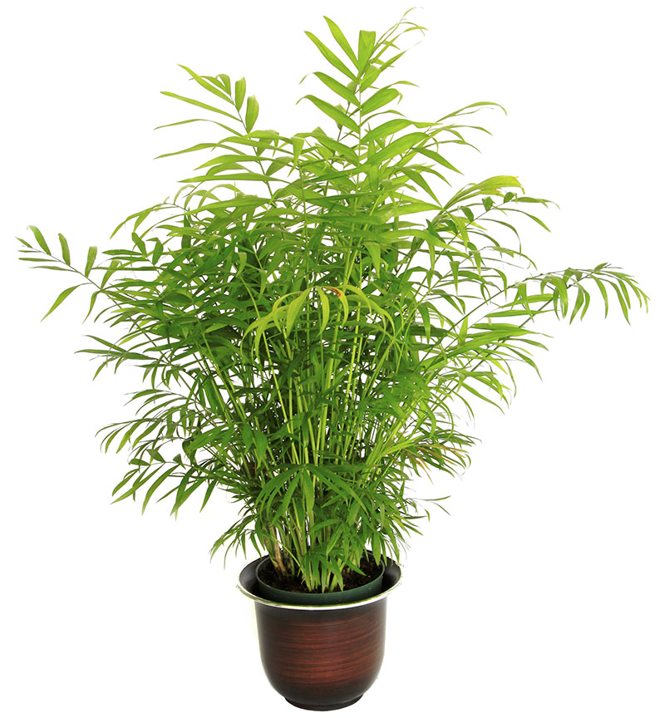
Beneficial Houseplants
Golden Pathos- clears pollutants from the air
Bamboo Palm- purifies air
Sake plant- soaks up carbon dioxide and releases oxygen for a better night sleep!
Ferns- moisture control

Slide 7
Extra Info!
Want to learn more? Check out these awesome websites for kids!
https://www.scienceforkidsclub.com/poisonous-plants.html
https://www.sciencekids.co.nz/plants.html

